Slide 1

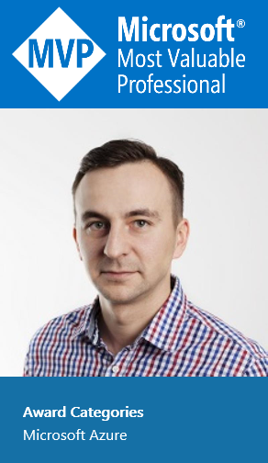





Sławek Stanek
Senior Cloud Architect
Microsoft MVP Azure
User group lider Microsoft User Group Poland w Poznaniu
https://www.facebook.com/stanekslawek
https://www.linkedin.com/in/slawomirstanek

Slide 2







Piotr Rogala
Current working in
Azure Cloud Architect Lead
MVP Azure
Blog:
Group leader:
@RogalaPiotr
linkedin.com/in/rogalapiotr

Slide 3

Microsoft Azure
Global Trusted Hybrid
Notes:
Reiterate foundational Azure pillars – anchor back the audience

Slide 4
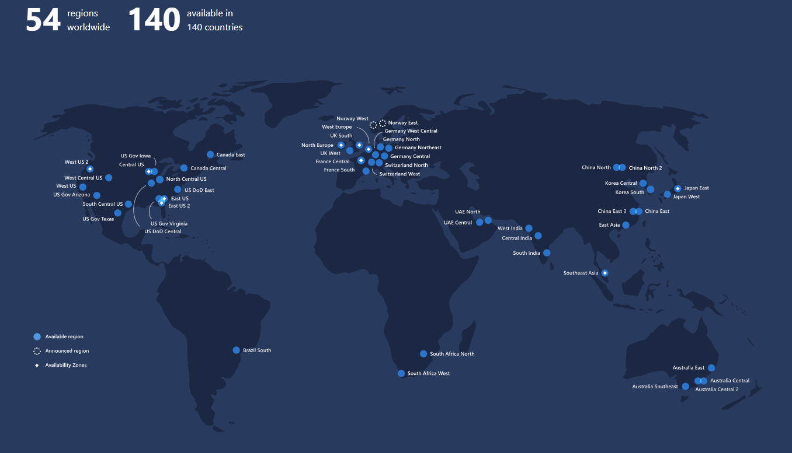

Slide 5
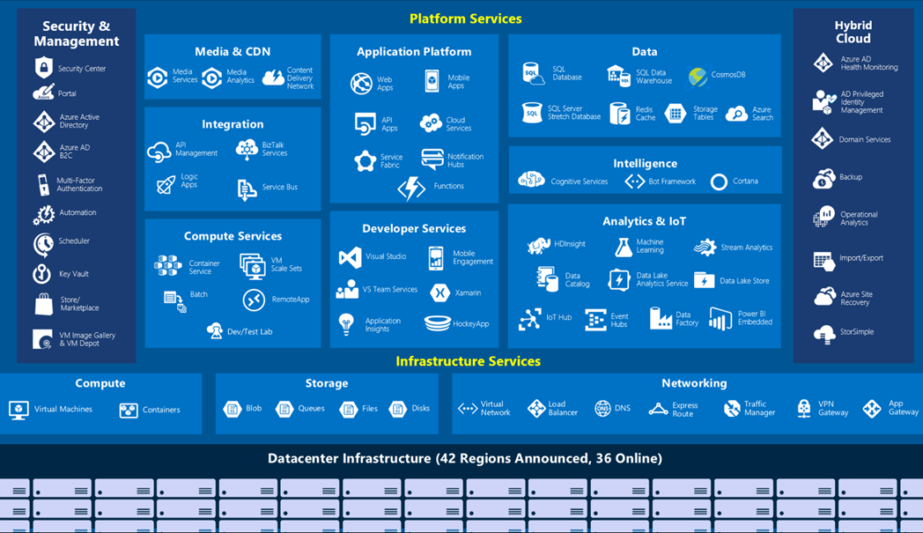
AZURE SERVICES
Why Cloud?
Notes:
Over the years Azure has introduced large number of services
Ready made services in areas of IoT and Analytics - provide huge competitive advantage over on-premise
All future software development is based on composable services in cloud
Very high investment level required - hence only 3+1 players

Slide 6
Azure & Azure DevOps & Git Hub
Azure
$200 for 30 days
12 months of popular free services
Always free 25+ services
Azure DevOps
Individuals – Free
Repository Public and Private - free
1 hosted job with 1,800 minutes per month for CI/CD
GitHub
Individuals – Free
Repository Public and Private - free
3 collaborators

Slide 7
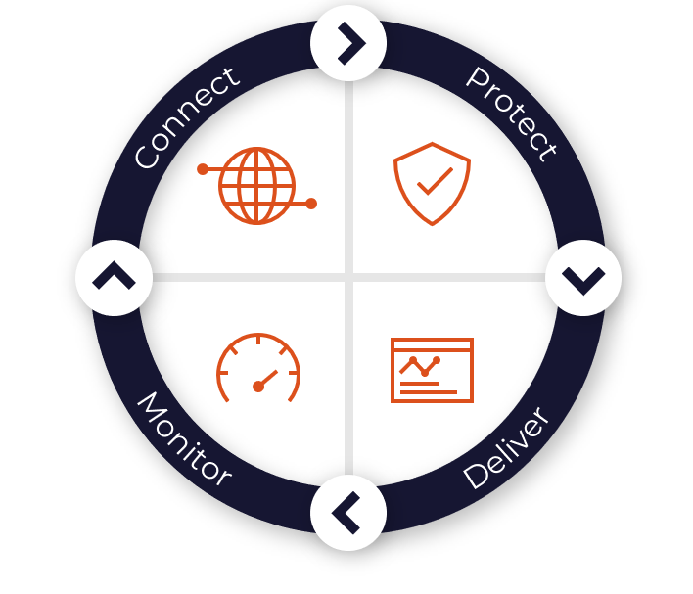
AZURE NETWORKING BASICS
DDoS Protection
Firewall
Network Security Groups
Web Application Firewall
Virtual Network Endpoints
Virtual Network
Virtual WAN
ExpressRoute
VPN
DNS
CDN
Front Door
Traffic Manager
Application Gateway
Load Balancer
Network Watcher
ExpressRoute Monitor
Azure Monitor
Virtual Network TAP

Slide 8



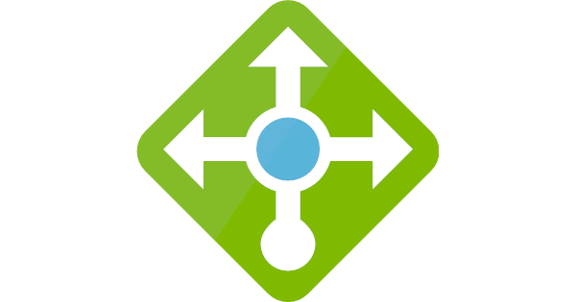




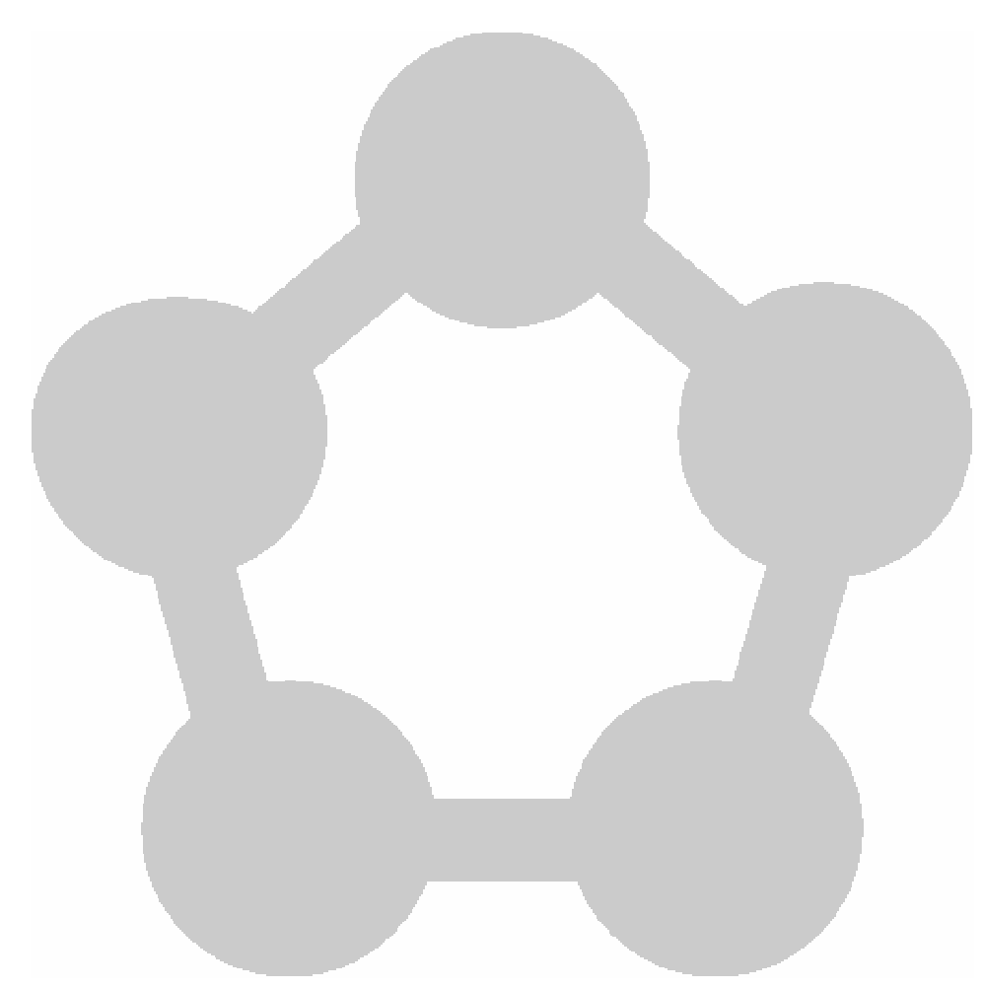







LOAD BALANCING IN AZURE
Azure cloud foundations workshop
Front Door
Application Gateway
Application Gateway
Traffic Manager
Load Balancer
(Public)
Load Balancer (Internal)
Global
Region / Zone
Global
Regional
Internal
Route to your closest available service region or your on-prem DC. Offload SSL, improve performance / accelerate websites at the Edge.
Route across zones and into your VNET. Offload SSL and build your application-specific logic.
Route across and between your resources to build your regional application.

Slide 9
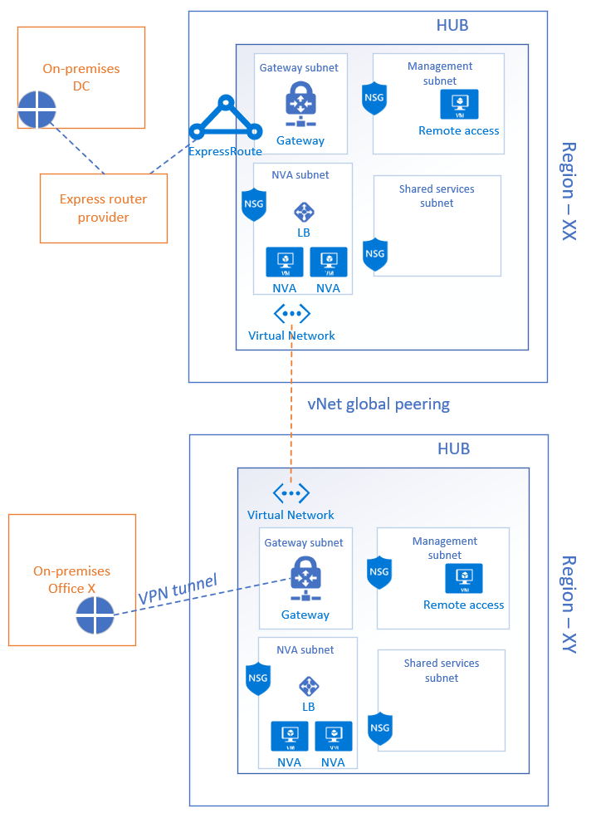
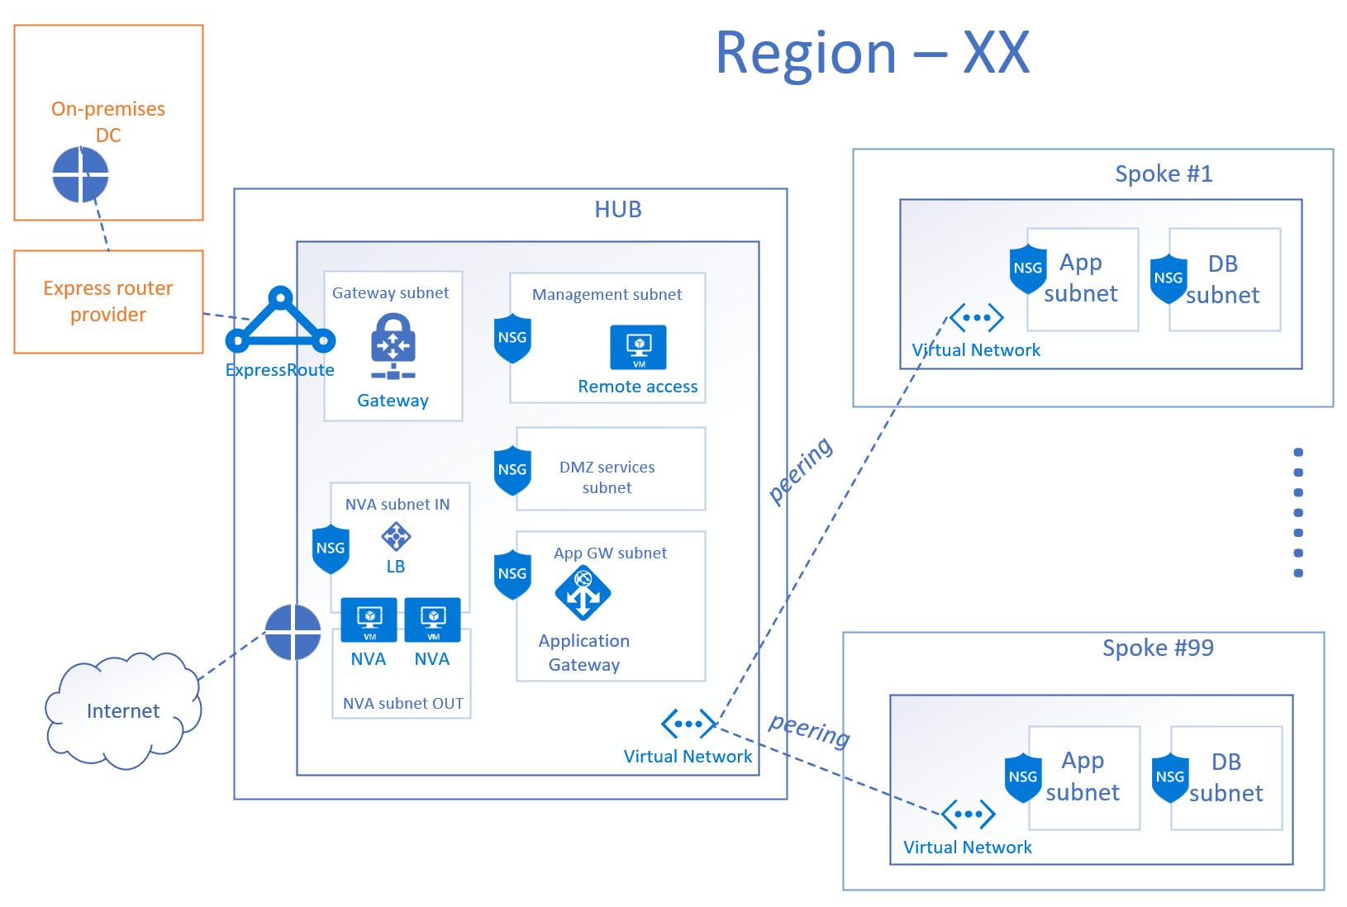
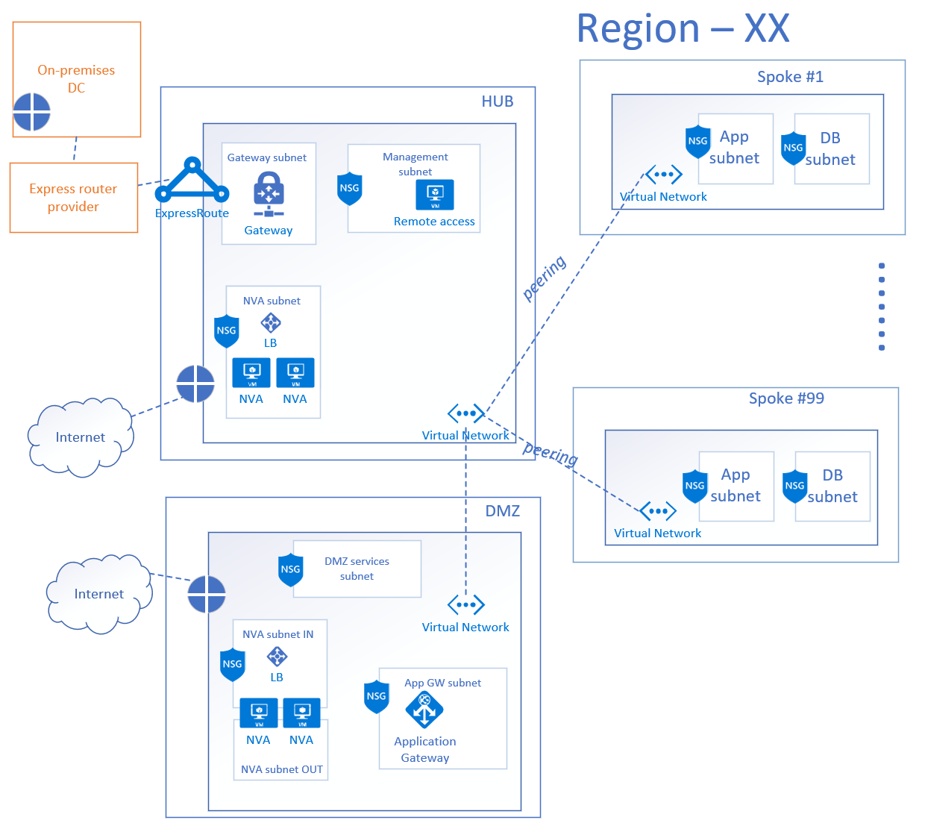
NETWORK PATTERN EXAMPLES
Azure Cloud Platform

Slide 10
NETWORK PATTERN EXAMPLES
Azure Cloud Platform

Slide 11
What is DevOps?
People. Process. Products.
Build& Test
Deploy
DevOps is the union of people, process, and products to enable continuous delivery of value to your end users.
“
Continuous Delivery
Develop
Operate
”
Plan & Track
Monitor & Learn

Slide 12
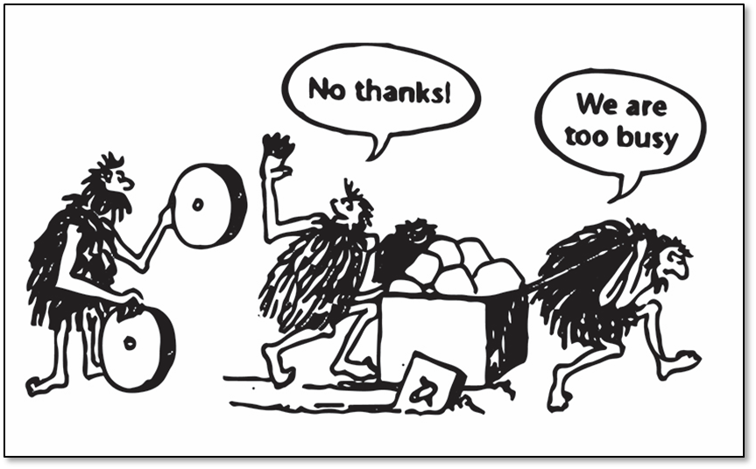

Slide 13
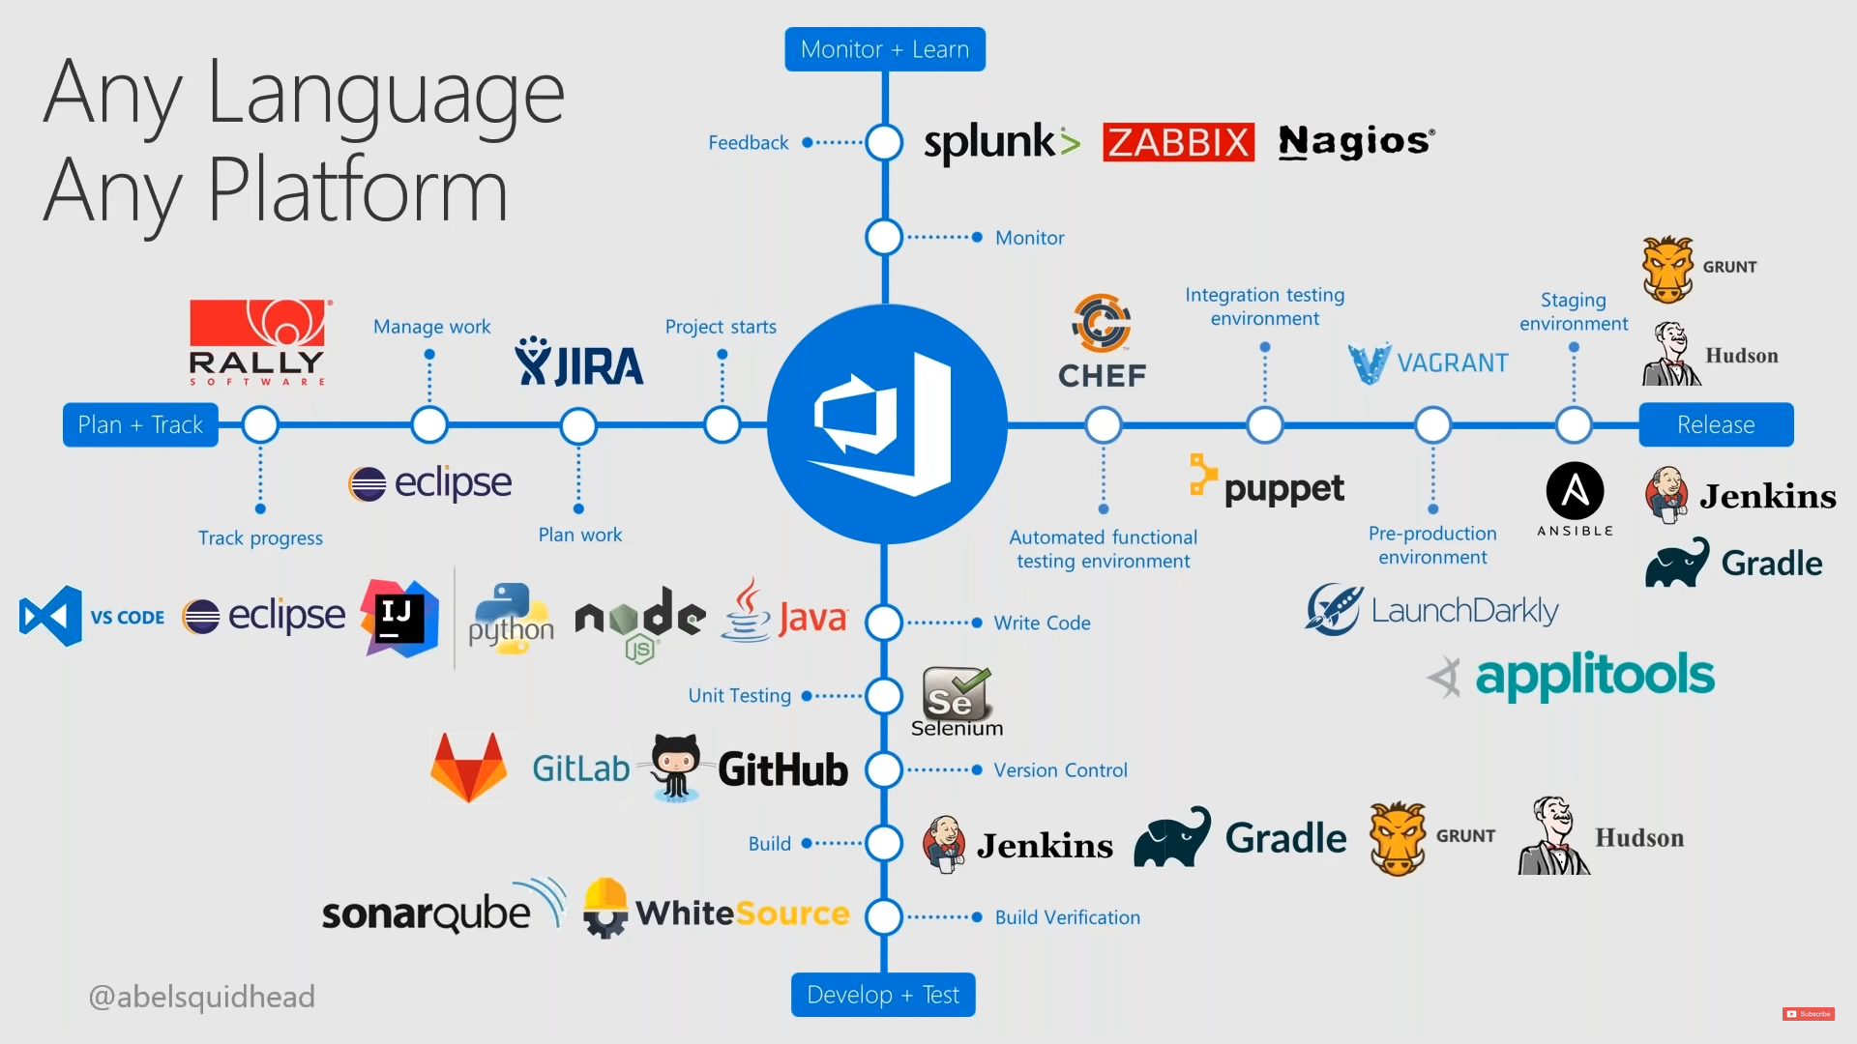

Slide 14
AUTOMATION ACROSS AZURE LIFECYCLE
MIGRATE
GOVERN
SECURE
Policy management
Cost management
Security management
Threat protection
CONFIGURE
Automation
PROTECT
Configuration
Update management
Backup
Disaster recovery
MONITOR
App, Infra & Network monitoring

Slide 15
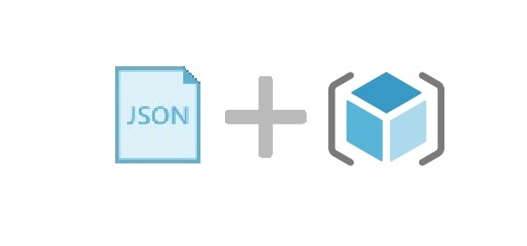

What is Infrastructure as Code (IaC)?
DevOps Concept
Infrastructure as Code is a process of managing and provisioning computing infrastructure with declarative approach while setting their configuration using definition files instead of traditional interactive configuration tools
Notes:
Check - validation option, deployment test.

Slide 16




INFRASTRUCTURE AS CODE (IAC)
DevOps Concept
What is
Descriptive model
Leverage version control
Key DevOps practices
Continuous delivery
Why
Infrastructure drifts
Inconsistent settings management
Reproduce environments
Manual processes
Hard-to-track configurations
Technologies
Terraform
Ansible
DSC
CHEF

Slide 17
Main benefits of Infrastructure as Code
DevOps Concept
Consistency Consistently achieve standardised provisioning or deployment
Accelerating Accelerating provisioning or deployment rapidly
Reusability Reusable JSON code for repeatable or similar provisioning or deployment
Extensibility IaC is a key DevOps practice and is used in conjunction with continuous delivery.

Slide 18







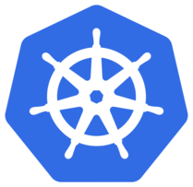
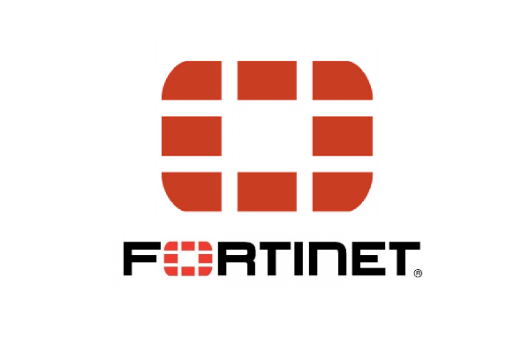
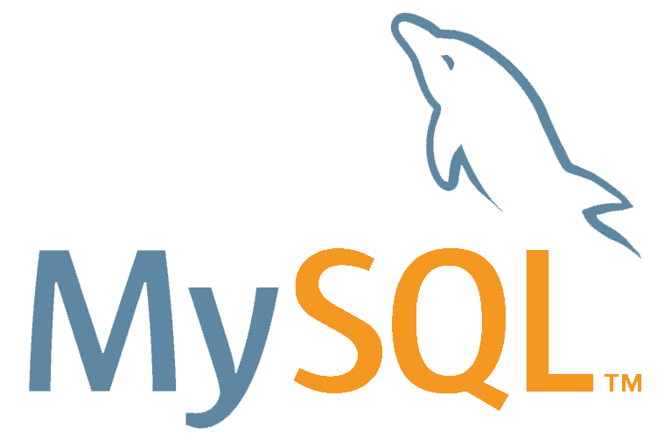
PROVIDER
Terraform Basics
Terraform is used to create, manage, and update infrastructure resources.
A provider is responsible for understanding API interactions and exposing resources.
https://www.terraform.io/docs/providers/index.html

Slide 19
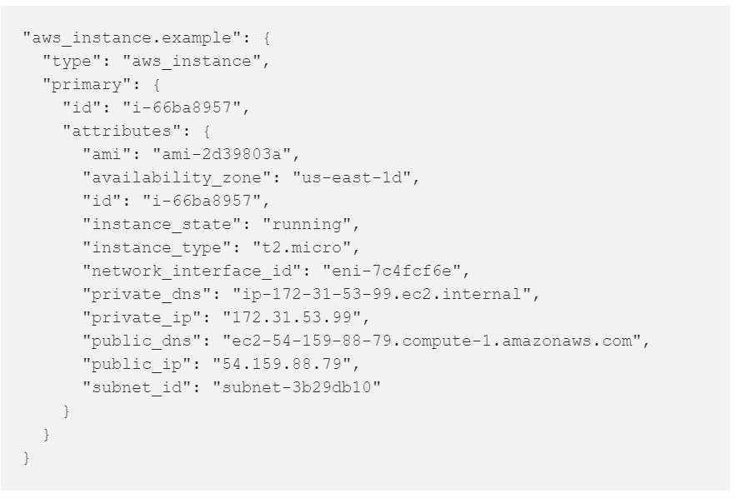
WHAT IS THE TFSTATE
Terraform Basics
The tfstate file is used by Terraform to map real world resources to your configuration, keep track of metadata, and to improve performance for large infrastructures
Is stored by default in a local file named "terraform.tfstate", but it can also be stored remotely.

Slide 20
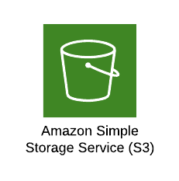
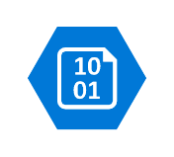
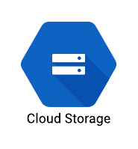

BACKEND
Terraform Basics
A "backend" in Terraform determines how state is loaded and how an operation such as apply is executed. This abstraction enables non-local file state storage, remote execution, etc.
By default Terraform uses the "local" backend
Working in a team: Backends can store their state remotely and protect that state with locks to prevent corruption.
Keeping sensitive information off disk: State is retrieved from backends on demand and only stored in memory.
Remote operations

Slide 21
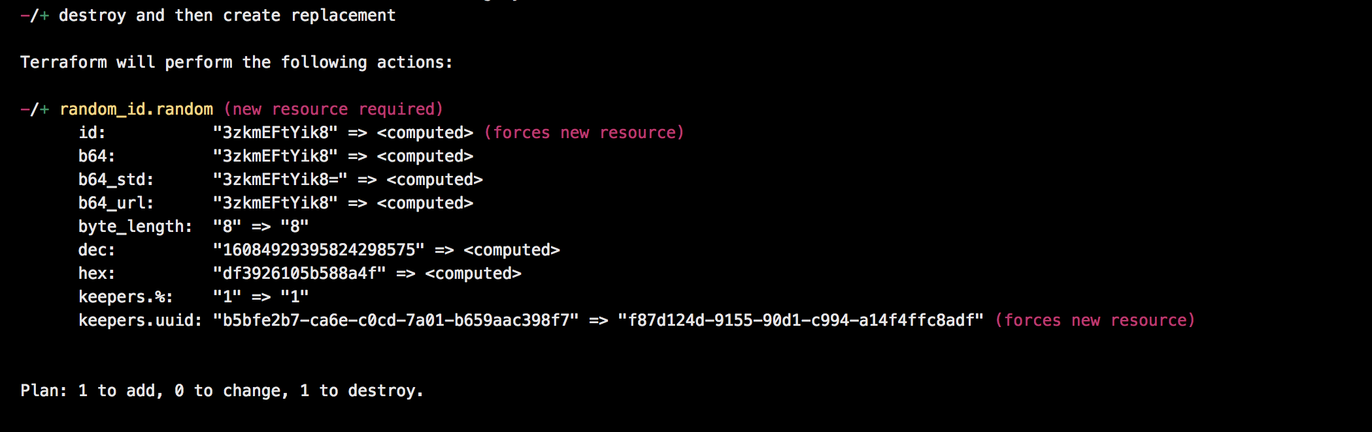
PLAN-APPLY-VALIDATE
Terraform Basics
The terraform apply command is used to apply the changes required to reach the desired state of the configuration, or the pre-determined set of actions generated by a terraform plan execution plan.
The terraform validate command is used to validate the syntax of the terraform files. Terraform performs a syntax check on all the terraform files in the directory, and will display an error if any of the files doesn't validate.
The terraform plan command is used to create an execution plan. Terraform performs a refresh, unless explicitly disabled, and then determines what actions are necessary to achieve the desired state specified in the configuration files.

Slide 22
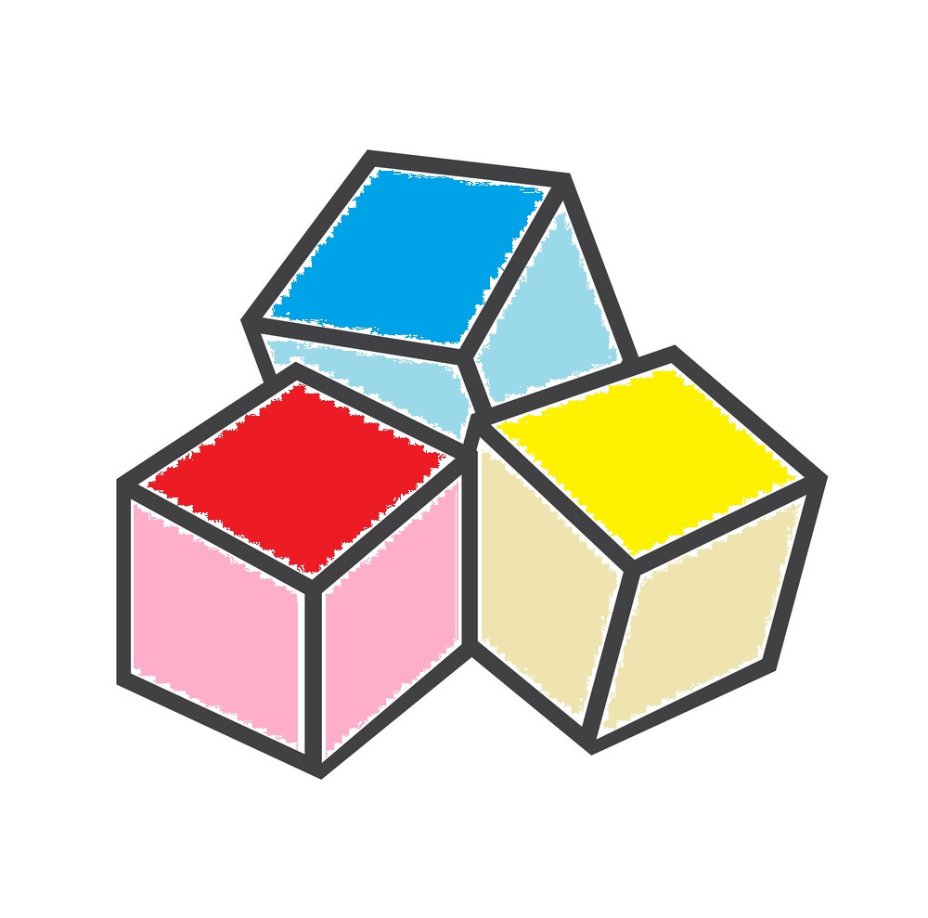
IMPORT / DESTROY
Terraform Basics
Terraform import is able to import existing infrastructure. This allows you take resources you've created by some other means and bring it under Terraform management.
Infrastructure managed by Terraform will be destroyed with command terraform destroy.
Notes:
This will ask for confirmation before destroying. If -auto-approve is set, then the destroy confirmation will not be shown.

Slide 23
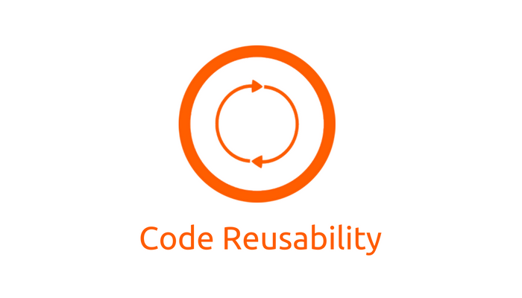
Moduls
Project Organization
A module is a container for multiple resources that are used together.
A module can call other modules, which lets you include the child module's resources into the configuration in a concise way.
Notes:
Modules can be used to create lightweight abstractions, so that you can describe your infrastructure in terms of its architecture, rather than directly in terms of physical objects.
Modules can also be called multiple times, either within the same configuration or in separate configurations, allowing resource configurations to be packaged and re-used.

Slide 24
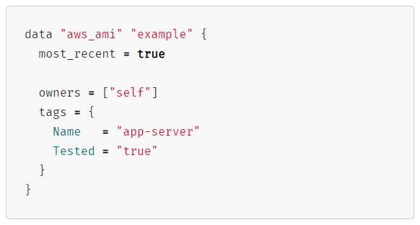
DATASOURCES
Project Organization
Data sources allow data to be fetched or computed for use elsewhere in Terraform configuration. Use of data sources allows a Terraform configuration to make use of information defined outside of Terraform, or defined by another separate Terraform configuration.
Data Resource Behavior:
Undefined query values
Apply phase
Constant query values
Refresh phase
Notes:
If the query constraint arguments for a data resource refer only to constant values or values that are already known, the data resource will be read and its state updated during Terraform's refresh phase, which runs prior to creating a plan.
Query constraint arguments may refer to values that cannot be determined until after configuration is applied, such as the id of a managed resource that has not been created yet. In this case, reading from the data source is deferred until the apply phase.

Slide 25
DEPENDS_ON
Project Organization
module “loc_ami” {
source = “../../modules/loc_ami”
}
module “app1” {
source = “../../modules/app”
name = “my_cool_app”
num_instances = 1
associate_public_ip = true
ami = “${module.loc_ami.ami_id}”
instance_type = “t2.medium”
}
Implicit dependency
Terraform allows to explicitly define inter-resource dependencies with “depends_on” meta-argument to define the order in which resources are deployed.
At the same time implicit dependencies are done with interpolation expressions.
resource "aws_s3_bucket" "example" {
bucket = "terraform-getting-started-guide"
acl = "private"
}
resource "aws_instance" "example" {
ami = "ami-2757f631"
instance_type = "t2.micro"
depends_on = [aws_s3_bucket.example]
}
Explicit dependency
Notes:
is able to infer a dependency between resources in the same module. But depends on the resource, that dependency can not be inferred directly and needs to be explicitly defined with depends_on keyword.
Dependencies across modules (at the moment) can only be done creating some implicit dependency using out and input variables across the 2 affected modules. If more modules are affected. Please, review architecture.

Slide 26

OBJECT TYPES
Project Organization
variable "images" {
type = "map(object({ network_num=number, az_zone=string }))"
default = {
production_a = {
network_num = 1
az_zone = "us-east-1a"
}
production_b = {
network_num = 2
az_zone = "us-east-1b"
}
staging_a = {
network_num = 1
az_zone = "us-east-1a"
}
}
}
New objects types in version 0.12.
variable "person" {
type = "object({ name=string, age=number })"
default = "{ name = "John", age = 52}"
}
variable "zones" {
type = "tuple([string, number, bool])"
default = ["a", 12, true]
}

